Slide 1
Directed study review
How did you find writing the story?
How did you get on with Finding Stories in Spreadsheets?
Any story ideas?

Slide 2
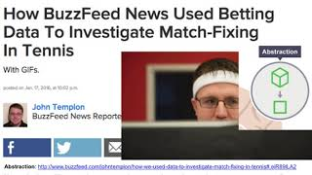
Video version of the lecture

Slide 3
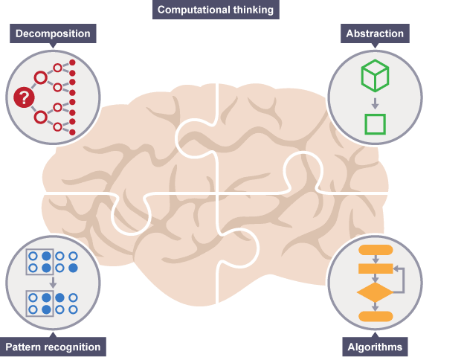

Computational thinking
@PaulBradshaw MED7373 Data Journalism
MA Data Journalism, Birmingham City University #bcujournos

Slide 4
Key points:
How computational thinking helps you be a better journalist
Breaking it down… functions
Problematising computationality

Slide 5
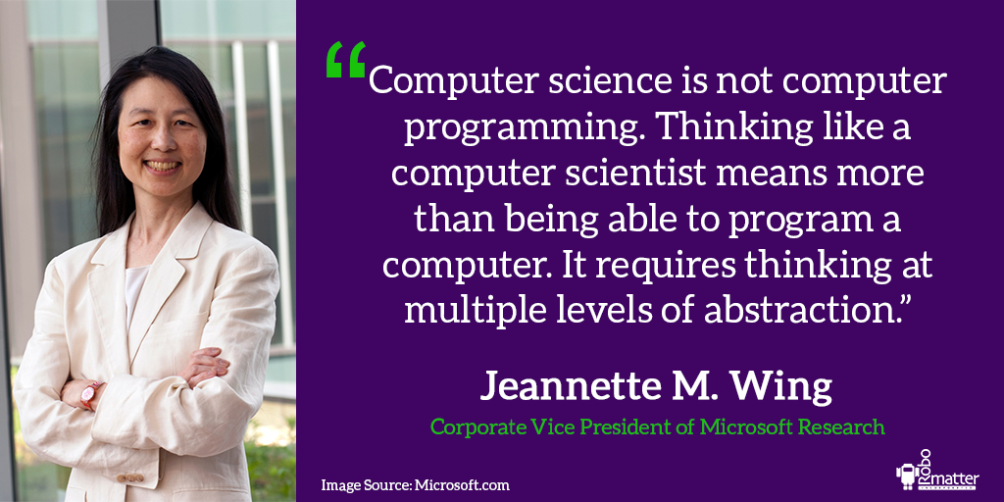
https://www.robomatter.com/cs-ed-wing/
Notes:
“When your daughter goes to school in the morning, she puts in her backpack the things she needs for the day; that’s prefetching and caching. When your son loses his mittens, you suggest he retrace his steps; that’s backtracking. At what point do you stop renting skis and buy yourself a pair?; that’s online algorithms.” Jeannette M. Wing

Slide 6
Read more here
Notes:
“When your daughter goes to school in the morning, she puts in her backpack the things she needs for the day; that’s prefetching and caching. When your son loses his mittens, you suggest he retrace his steps; that’s backtracking. At what point do you stop renting skis and buy yourself a pair?; that’s online algorithms.” Jeannette M. Wing

Slide 7
"Journalism taught me how to ask questions. Computer Science taught me the importance of asking the right question.
"Journalism taught me how to communicate. Computer Science taught me how to think.
"Journalism taught me how to identify problems. Computer Science taught me how to solve problems.”
Mark Donoghue, in the Online Journalism Handbook (2nd ed) p296

Slide 8
Decomposition: Adrian Holovaty
“An obituary is about a person, involves dates and funeral homes.
“A wedding announcement is about a couple, with a wedding date, engagement date, bride hometown, groom hometown and various other happy, flowery pieces of information.”
A fundamental way newspaper sites need to change (2016)

Slide 9
...led to Politifact +
Structured Journalism
“Politifact first created a database of political statements which could then be used to generate stories, graphics, and other varieties of journalistic output. First the database, then the narrative.”
CW Anderson (2018) Apostles of Uncertainty

Slide 10

Trial and error = decomposition

Slide 11
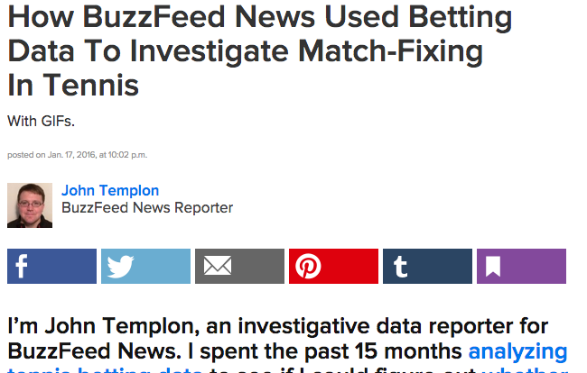

Abstraction: BuzzFeed
Abstraction: http://www.buzzfeed.com/johntemplon/how-we-used-data-to-investigate-match-fixing-in-tennis#.eiR89lLA2

Slide 12
Pattern recognition...
Column A
Column B
Column C
Row 1
Numbers | Strings | Calculations
10 | John Smith | =10+20+30
20 | Kate Brown | =A2+A3+A4
30 | Mike Moore | =SUM(A2:A4)
N/A | Kim Smith | =COUNT(A:A)
50 |  | =COUNTA(B:B)
Row 2
Row 3
Row 4
Row 5
Row 6

Slide 13
Pattern recognition...
Column A
Column B
Column C
Row 1
CELL A1 | CELL B1 | CELL C1
CELL A2
CELL A3
 | WHAT’S THIS ONE?
Row 2
Row 3
Row 4
Row 5
Row 6

Slide 14
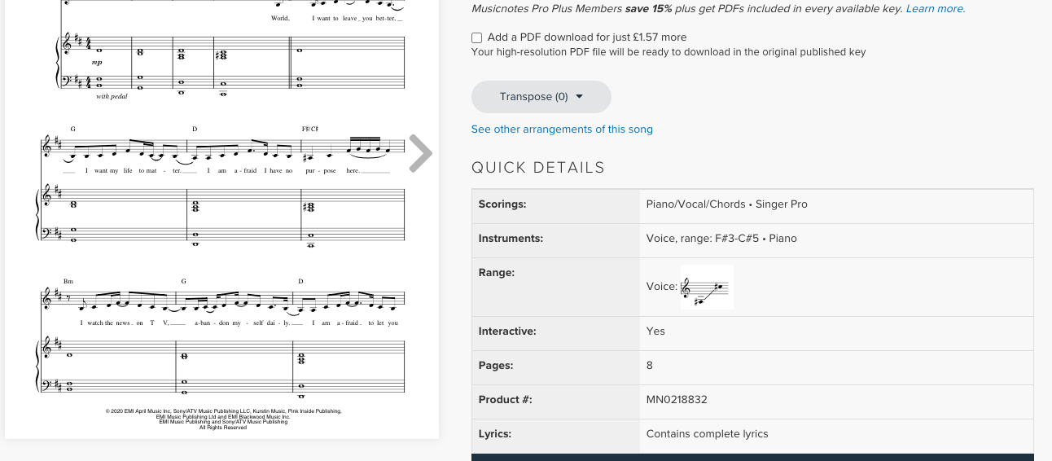
Pattern recognition...

Slide 15
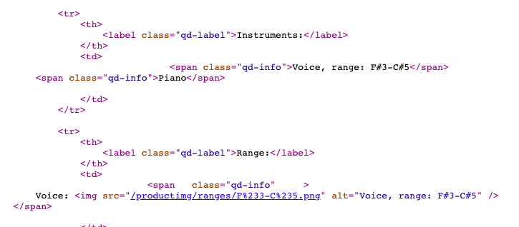
Pattern recognition...

Slide 16
Pattern recognition...
https://www.musicnotes.com/ sheetmusic/mtd.asp? ppn=MN0218832

Slide 17
Algorithms?
They can be written in code…
#import one CSV to form the dataframe that we can add others to
certsdf <- readr::read_csv('all-domestic-certificates/domestic-_unknown_local_authority--Unknown-Local-Authority-/certificates.csv')
#loop through the list of folders - we limit it to the next 9 for now
for (i in folderlist[2:10]){
#create a path to the certificates CSV in the particular subfolder
fullpath <- paste0('all-domestic-certificates/',i,'/certificates.csv')
#import that file
tempdf <- readr::read_csv(fullpath)
#append to the ongoing file
certsdf <- rbind(certsdf, tempdf)
}
https://github.com/BBC-Data-Unit/energy-efficiency-private-rental/blob/main/scripts/energyeff01compile.md

Slide 18
…or in a spreadsheet formula…
=AVERAGE(A2:A3000)
Translation: add up all the numbers in the cells A2 to A3000, and divide by the amount of numbers there are

Slide 19
…or in a calculation, copied down a column of cells
=A2-B2
=A3-B3
=A4-B4
When you copy a formula into another cell, it changes the cell references to apply to that row

Slide 20
An example:
I want the area codes for a column of phone numbers
The phone number is in two parts
The second part is always 7 digits
If I strip away those 7, I’m left with the area code

Slide 21
One recipe (algorithm) for solving that:
=LEFT(A2,LEN(A2)-7)
Measure length of A2
Subtract 7
Extract, from the left, that many characters from A2

Slide 22
‘Problematising computationality’
“Think critically about how knowledge in the 21st century is transformed into information through computational techniques, particularly within software.”
David M. Berry

Slide 23
Summary:
Break stories down into different problems/stages to solve
Look at data like a computer: it’s not a word, it’s a series of characters. It’s not a date, it’s a formatted number
Functions are algorithms (recipes) — you can make your own with IF, nesting, and coding

Slide 24
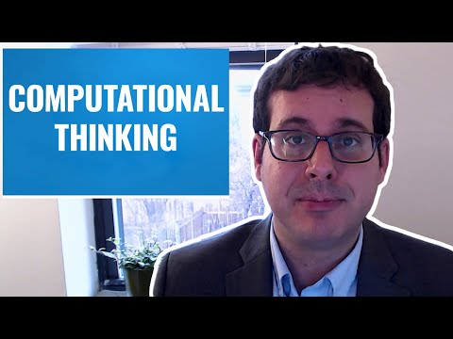

Slide 25
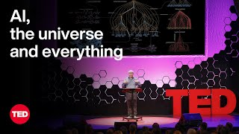

Slide 26
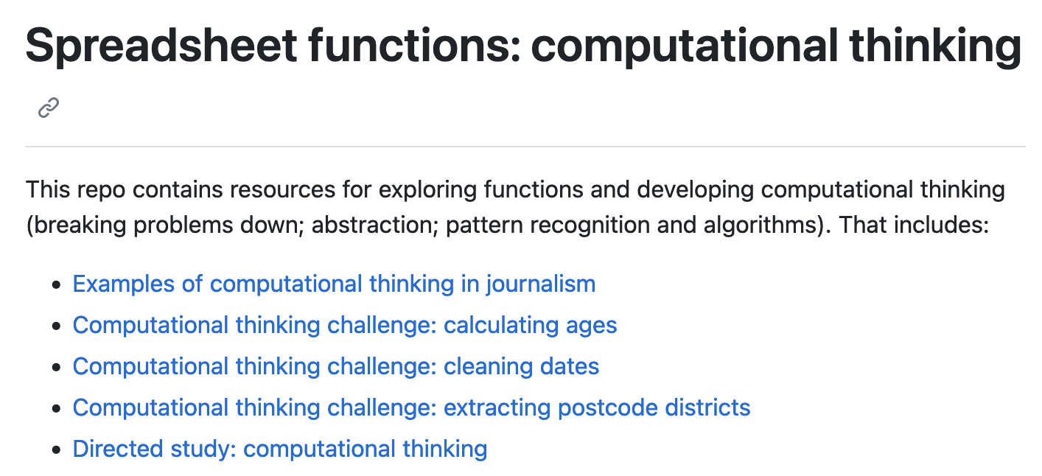
Have a play in the repo!
https://github.com/paulbradshaw/MED7373-Data-Journalism/tree/master/2functions

Slide 27


Be clear what you
are measuring
Not all data is equal

Slide 28
Measurement scales
Nominal: categories without order, e.g. ethnicity, gender, home town etc.
Ordinal: categories in order, e.g. ‘very happy’, ‘happy’, ‘unhappy’.
Interval: “Variables with equal intervals between values”, e.g. temperature and time
Ratio: measurable choices within ‘buckets’, e.g. ‘<£10’, ‘£10-£50’, ‘£50+’.
https://www.questionpro.com/blog/nominal-ordinal-interval-ratio/

Slide 29
Offers: | Nominal | Ordinal | Interval | Ratio
The sequence of variables is established | – | Yes | Yes | Yes
Mode | Yes | Yes | Yes | Yes
Median | – | Yes | Yes | Yes
Mean | – | – | Yes | Yes
Difference between variables can be evaluated | – | – | Yes | Yes
Addition and Subtraction of variables | – | – | Yes | Yes
Multiplication and Division of variables | – | – | – | Yes
Absolute zero | – | – | – | Yes
https://www.questionpro.com/blog/nominal-ordinal-interval-ratio/

Slide 30
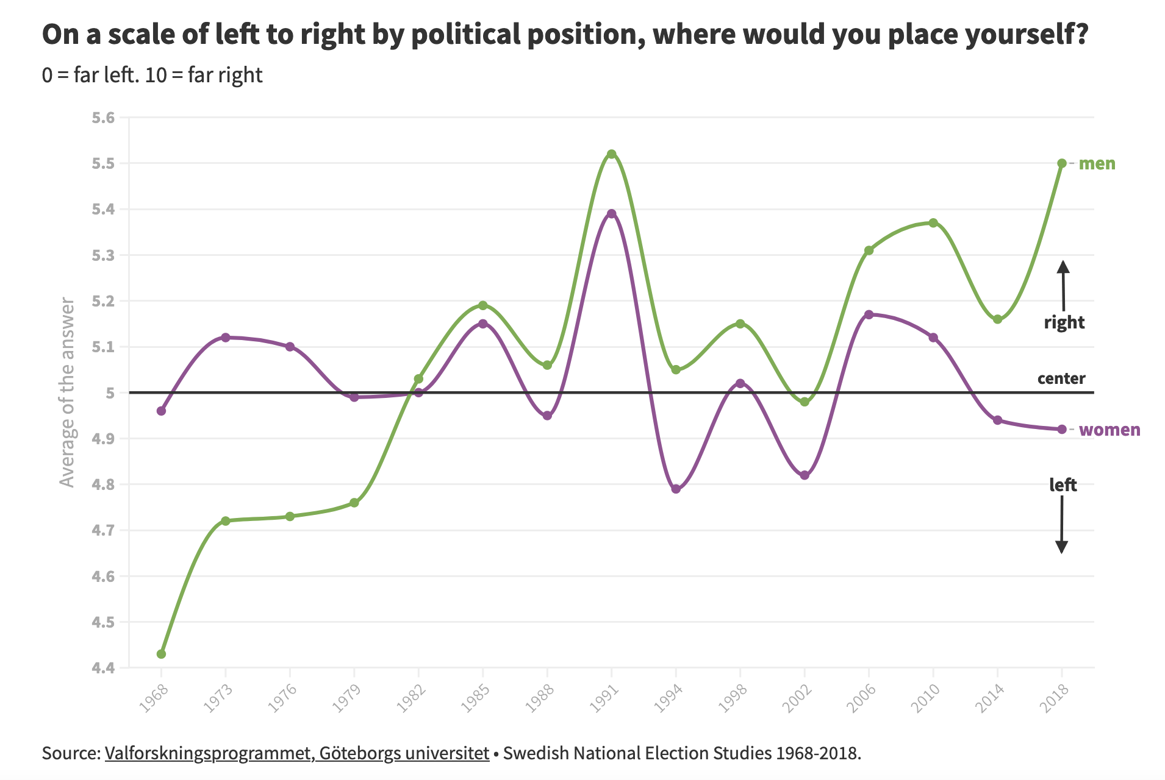
Which is this?

Slide 31
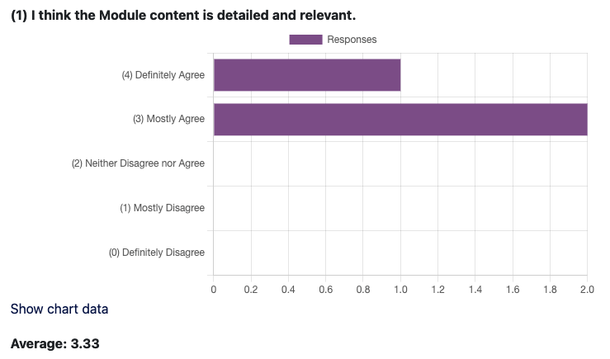
Which is this?

Slide 32
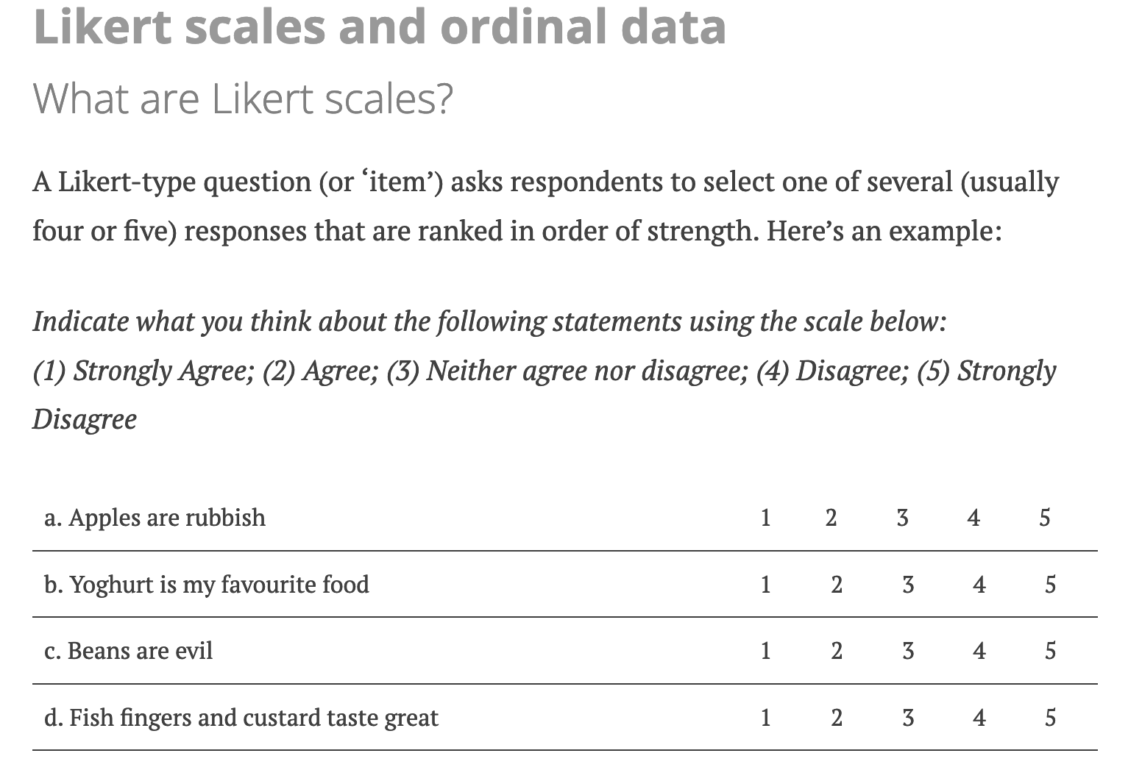
https://achilleaskostoulas.com/2013/02/13/on-likert-scales-ordinal-data-and-mean-values/#Likert

Slide 33
Discuss: average rating
You have data on ratings out of 10 - is it fair to average those?
What about mid-module survey results?
How could we analyse it differently?
How could we visualise the left/right political position data differently?

Slide 34
Directed study:
Identify a story/dataset that presents a small challenge
Break the challenge down into problems
Identify what you need to do - find functions that can do it
Write the story!
+ Add quotes (interviews)

